Slide 1

.
GROUP 13

Slide 2
INTRODUCTION.
The International Union for Conservation of Nature’s Red List of threatened species, established in 1964.
Source of information on the global extinction risk status of animals, plant and fungus species.
It consist of species group including mammals, amphibians, birds, reef building corals and conifers.
It is a powerful tool to inform and catalyze action for biodiversity conservation.

Slide 3
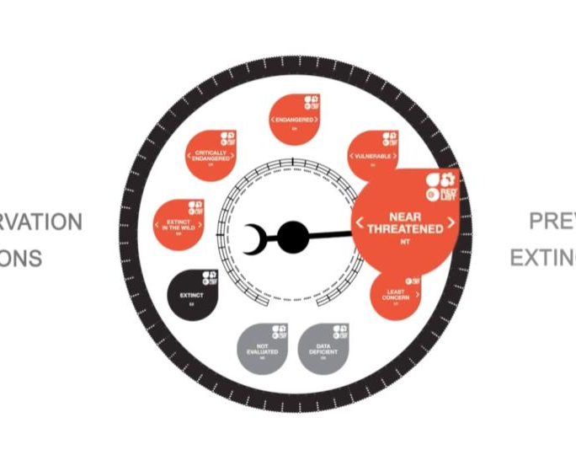
The barometer of life
The IUCN red list re-assesses the status of some existing species.
Currently there are more than 150,300 species on the IUCN red list, with more than 42,100 species threatened with extinction.
41% of amphibians, 37% of sharks and rays, 36% of reef building corals, 34% of conifers, 27% of mammals and 13% of birds.
Fig 1; The barometer of life

Slide 4
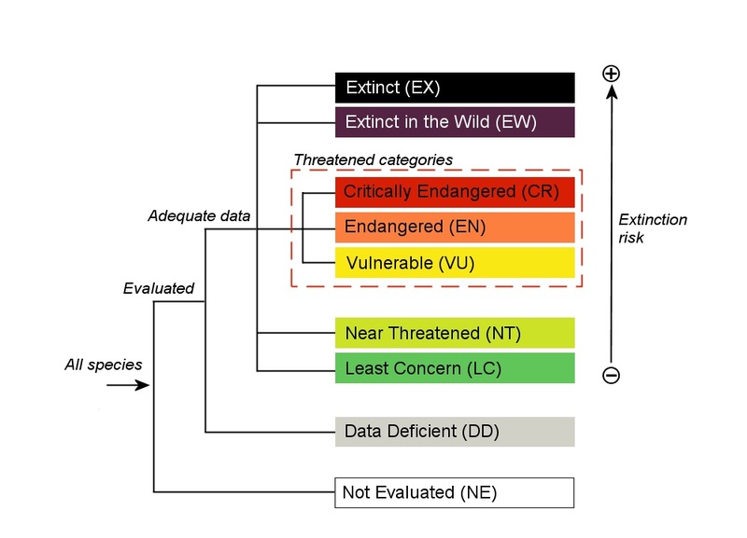
THE IUCN RED LIST CATEGORIES.
Not Evaluated (NE)
Data Deficient (DD)
Least Concern (LC)
Near Threatened (NT)
Vulnerable (VU)
Endangered (EN)
Critically Endangered (CR)
Extinct In the Wild (EW)
Extinct (EX)
Fig 2; IUCN Categories

Slide 5
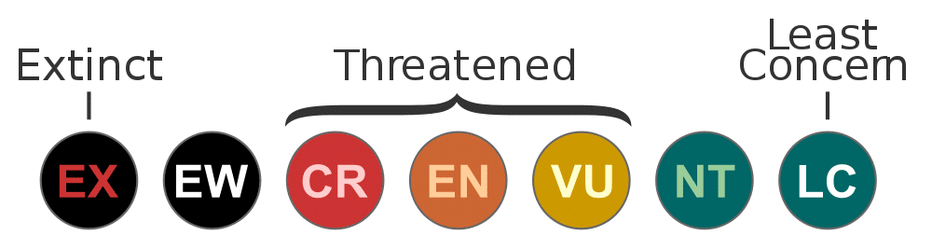
THE CRITERIA USED TO ASSESS THE EXTINCTION RISK OF SPECIES
The rate of population decline.
The geographic range.
Whether the species already possesses a small population size.
Whether the species lives in a restricted area.

Slide 6
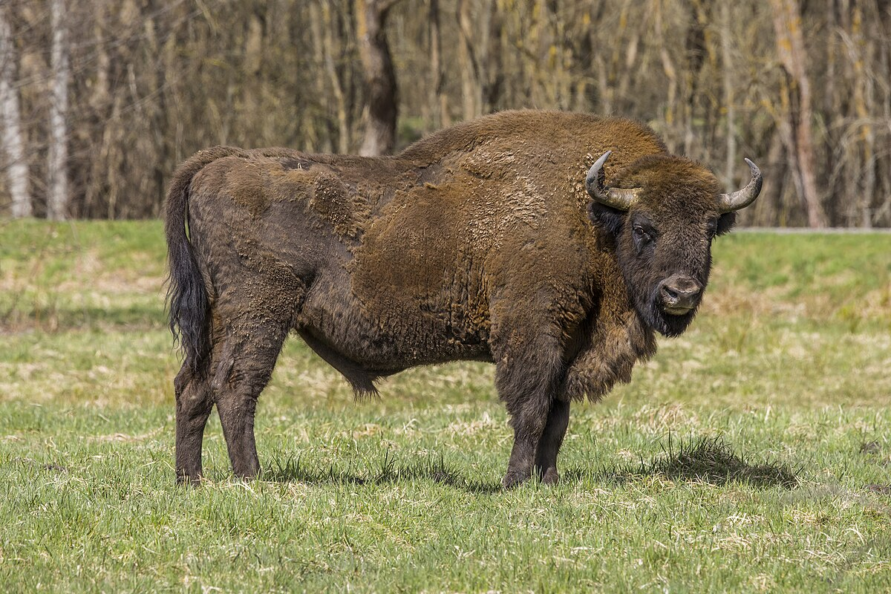
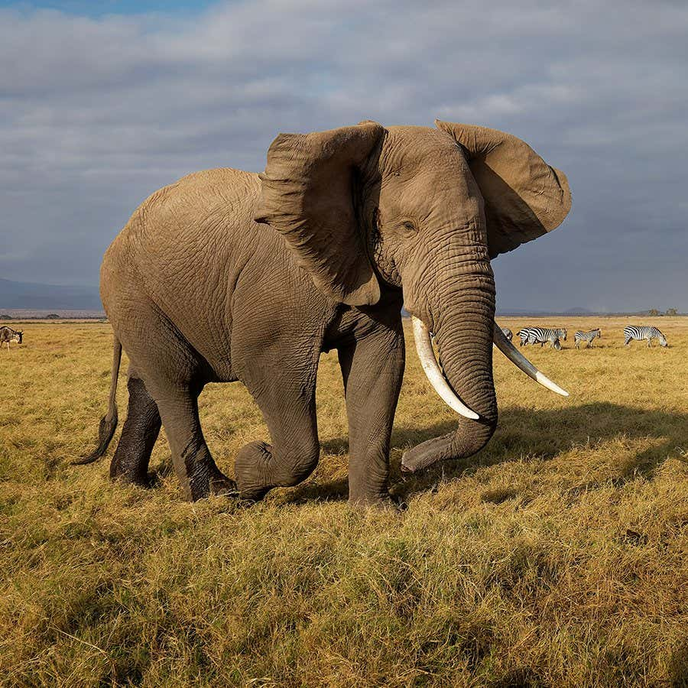
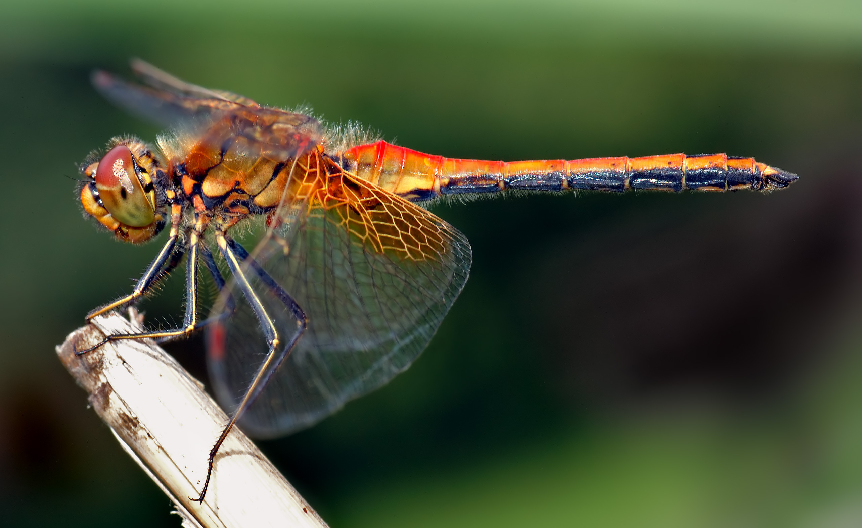
FEATURED RED LIST WORK.
Fig 3; European Bison
Fig 4; African Elephant
Fig 5; Dragonfly

Slide 7
HOW THE RED LIST IS USED.
The IUCN red list show us where and what actions need to be taken to save the building blocks of nature form extinction.
Guiding scientific research.
It provides data for the indicators needed to measure progress towards the achievement of the United Nations Sustainable Development Goals (SDGs), particularly goal 15.
Informing conservation planning.

Slide 8
LIMITATIONS OF THE IUCN RED LIST.
It is not possible to apply the red list criteria on a fragmentary data.
It requires skilled conservation assessment team.
The red list focus on current conditions of species which may exacerbate this inaccuracy in the data.
The red list does not take into account the value of genetic information and addressing the issue of species with fewer genetic relatives
The red list has been described as ambiguous.

Slide 9
CONCLUSION.
“The IUCN Red list tells us where we ought to be concerned and where the urgent needs are to do something to prevent the despoliation of this world. It is a great agenda for the work of conservationist” Sir David Attenborough.

Slide 10
REFRENCES.
Dublin, Holly. “IUCN Red List of Threatened Species”. Encyclopedia Britannica, 15 Mar. 2023, https://www.Britannica.com/topic/IUCN-Red-List-of-Threatened-Species. Accessed 19 July, 2023.
IUCN 2023. The IUCN Red List of Threatened Species. Version 2022-2. https://www.iucnredlist.org. ISSN 2307-8235.
Rosie Walker (2019). Strengths and limitations of the IUCN Red list for setting conservation priorities.

Slide 11
THANK YOU.
.

